Slide 1
Scoliosis Protein Tyrosine Kinase 7
Austin Staudinger

Slide 2
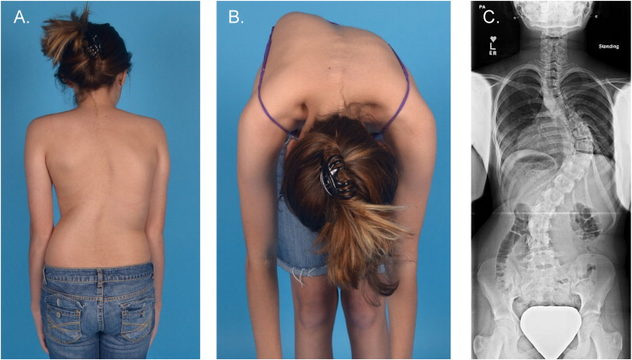
What is scoliosis?
Scoliosis is sideways curvature of the spine in a C- or S-shape

Slide 3
What gene is linked to scoliosis?
PTK7
Biological Process
Cellular Component
Molecular Function
Protein Tyrosine Kinase Activity
Wnt Activated Planar Cell Polarity Pathway
Cell Membrane

Slide 4
How well is PTK7 conserved?

Slide 5
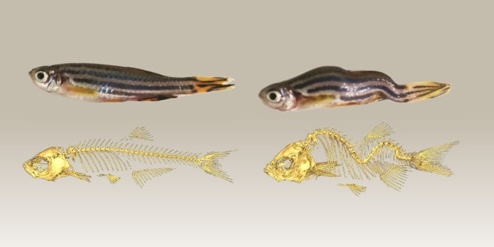
A Good Model for Scoliosis
Pressure from swimming forward is comparable to gravity for humans

Slide 7
What is the gap in knowledge?
It’s unclear how ptk7 mutations alter the Wnt/PCP signaling pathway

Slide 8
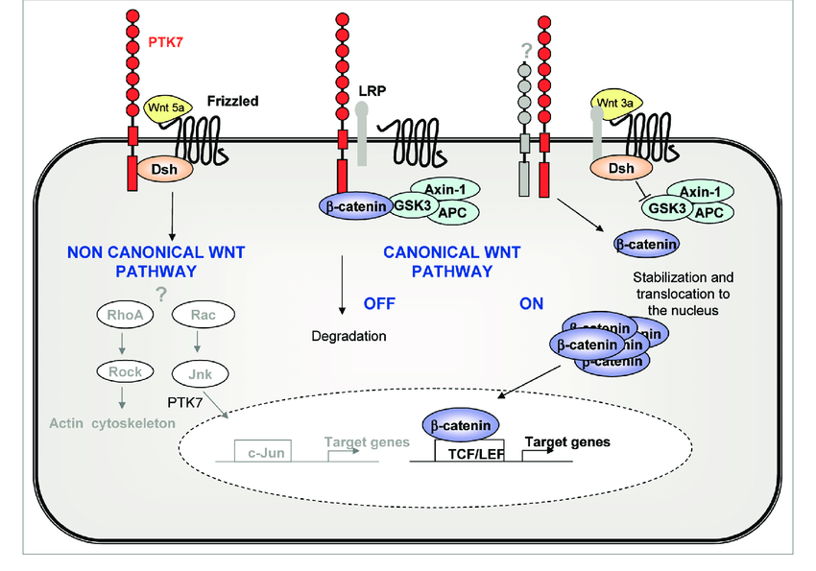
What is the Wnt/PCP signaling pathway?
The Wingless Integrated Planar Cell Polarity Signaling Pathway

Slide 9
Primary Goal
To discover how mutated ptk7 alters the Wnt signaling pathway
Aims
Identify mutations that cause the disease phenotype
Determine mutant PTK7’s ability to regulate skeletal development proteins
Determine mutant PTK7’s ability to localize potential Wnt/PCP ligands

Slide 10
Aim 1: Identify novel mutations in the ptk7 gene that cause idiopathic or congenital scoliosis.
Step 1: Next Generation Sequencing

Slide 11
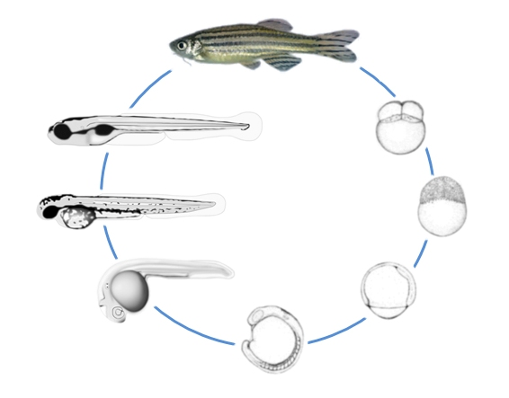
Aim 1: Identify novel mutations in the ptk7 gene that cause idiopathic or congenital scoliosis.
Step 2: Evaluate the phenotypes of variant groups
Larval stage
Adolescent stage through adulthood

Slide 12
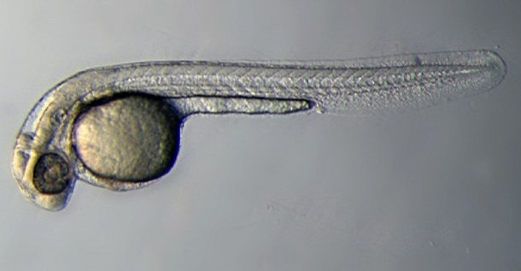
How do you evaluate at the larval stage?
Signs of congenital scoliosis in zebrafish:
Abnormal vertebrae size, shape, and alignment

Slide 13
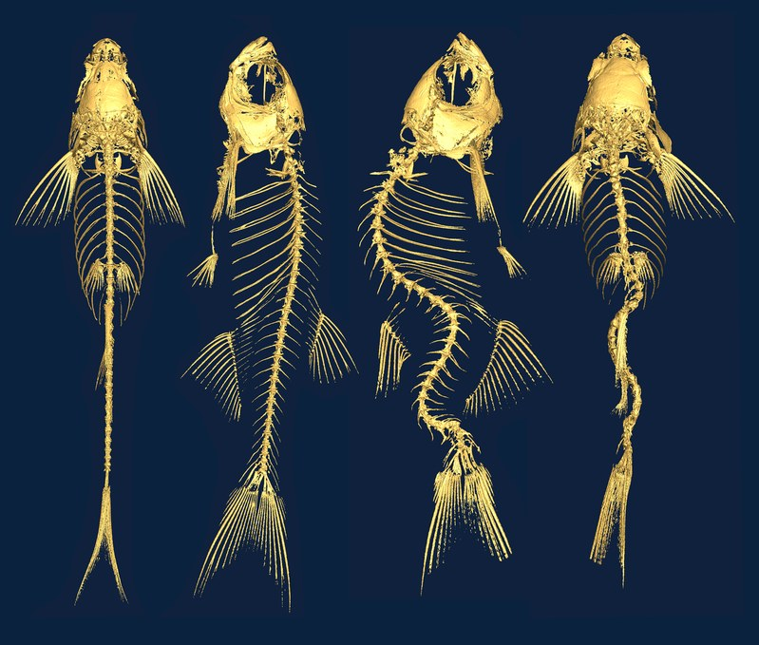
How do you evaluate during adolescence?
Signs of idiopathic scoliosis in zebrafish:
Abnormal length ratios
(dorsal:ventral and left:right)
Re-examination will track disease progression through adulthood

Slide 14
Aim 1: Identify novel mutations in the ptk7 gene that cause idiopathic or congenital scoliosis.
Rationale: We need to know which variants cause scoliosis, and how severe each variant is

Slide 15
Aim 1: Identify novel mutations in the ptk7 gene that cause idiopathic or congenital scoliosis.
Hypothesis: Next generation sequencing will find multiple sites of variation within the ptk7 gene, some of which will cause scoliosis with varying severity.

Slide 16
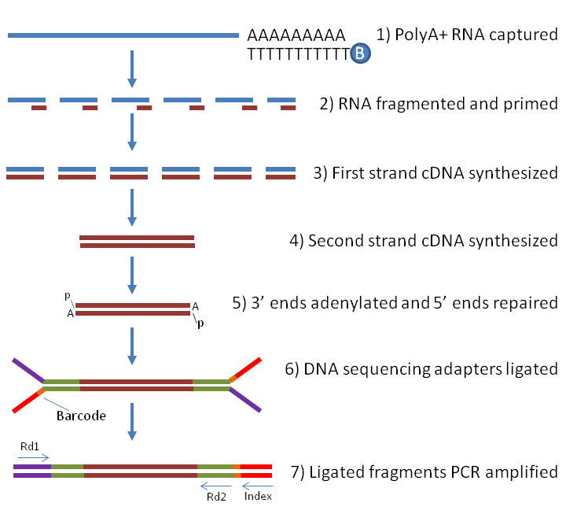
Aim 2: Determine if mutant ptk7 is an inefficient regulator of skeletal development proteins.
LRP6
Approach: Use GO and RNA-seq to measure expression of skeletal proteins in ptk7 mutants

Slide 17
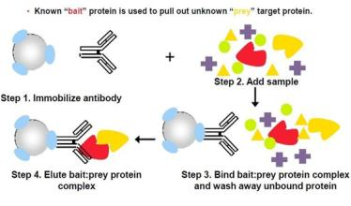
Aim 3: Determine how well mutant ptk7 can localize potential Wnt/PCP ligands.
Approach: Use Co-IP to determine how well mutant ptk7 binds Dsh

Slide 18
Conclusion
Scoliosis is associated with PTK7 mutations.
PTK7 regulates the Wnt/PCP signaling pathway.
PTK7 interacts with skeletal developmental proteins such as LRP6.
Mutations to PTK7 may hamper it’s ability to localize Wnt/PCP ligands.

Slide 19
References
https://www.sciencedirect.com/science/article/pii/S1040738315000052
https://directorsblog.nih.gov/2016/07/07/scoliosis-traced-to-problems-in-spinal-fluid-flow/
https://www.freepik.com/free-icon/standing-human-body-silhouette_738395.htm
https://www.researchgate.net/figure/Multiple-modes-of-action-of-PTK7-in-Wnt-signaling-Wnt-planar-cell-polarity-PCP_fig1_50420364
https://www.genengnews.com/magazine/286/next-generation-sequencing-challenges/
https://www.fishforpharma.com/why-zebrafish-17
https://embryology.med.unsw.edu.au/embryology/index.php/Zebrafish_Development
https://www.wired.com/2016/07/fish-creepy-curved-spines-help-explain-scoliosis/
http://geneontology.org/
https://www.labome.com/method/RNA-seq-Using-Next-Generation-Sequencing.html
https://www.creative-proteomics.com/blog/index.php/something-you-are-supposed-to-know-before-co-immunoprecipitation-experiment/

